Slide 1



INIT’26
PPT FORMAT
(
INIT'26 FINTECH HACKATHON // ASSET & CAPITAL MANAGEMENT TRACK
FortressFi : Autonomous Institutional Risk-Guardrail Portfolio Engine
INIT'26 FINTECH HACKATHON // ASSET & CAPITAL MANAGEMENT TRACK
FortressFi : Autonomous Institutional Risk-Guardrail Portfolio Engine

Slide 2
SLIDE 1 : TITLE SLIDE
TRACK : FinTech - Asset & Capital Management / Optimization Controls
PROBLEM STATEMENT : Automated Capital Management and Real-Time Risk Guardrail Optimization
TEAM NAME : Team FortressFi
IDEA TITLE : FortressFi - Institutional Adaptive Risk-Guardrail Portfolio Engine
💡 The Simple Human Idea Behind FortressFi : 'Cruise Control for Capital'
• Driving a car on a highway: You want cruise control to smoothly maintain your speed and save fuel.
• Sudden obstacle on the road: You need automatic emergency braking before you even realize you're in danger.
• FortressFi brings that exact balance to investment portfolios: it quietly maximizes returns when markets are steady, but the second risk metrics spike, it automatically taps the brakes and shields capital into safe cash and government bonds.
[CORE IDEA] The Simple Human Intuition Behind FortressFi : 'Cruise Control for Capital'
• Driving a car on a highway: You want cruise control to smoothly maintain your speed and save fuel.
• Sudden obstacle on the road: You need automatic emergency braking before you even realize you're in danger.
• FortressFi brings that exact balance to investment portfolios: it quietly maximizes returns when markets are steady, but the second risk metrics spike, it automatically taps the brakes and shields capital into safe cash and government bonds.

Slide 3
SLIDE 2 : PROPOSED SOLUTION
1. THE PROBLEM WE OBSERVED
Why existing systems fail real investors:
• Manual Rebalancing is Too Slow:
Monthly reviews or investment committees take days. In a flash crash, losses happen in minutes.
• High-Frequency Trading Destroys Profits:
Constantly trading on every small price tick racks up massive broker fees, turnover drag, and bid-ask slippage.
• Black-Box AI Lacks Trust:
Complex neural nets move millions without explaining 'why'. When panic hits, managers just turn them off.
1. THE PROBLEM WE OBSERVED
Why existing systems fail real investors:
• Manual Rebalancing is Too Slow:
Monthly reviews or investment committees take days. In a flash crash, losses happen in minutes.
• High-Frequency Trading Destroys Profits:
Constantly trading on every small price tick racks up massive broker fees, turnover drag, and bid-ask slippage.
• Black-Box AI Lacks Trust:
Complex neural nets move millions without explaining 'why'. When panic hits, managers just turn them off.
2. OUR SOLUTION: DECOUPLED DUAL ENGINE
Separating profit optimization from risk defense:
• Engine 1: The Accelerator (Optimizer)
Solves Mean-Variance quadratic optimization to find the highest Sharpe ratio while respecting liquidity bounds (Cash ≥ 5%).
• Engine 2: The Brakes (Risk Guardrail)
Independent safety governor tracking tail risk (CVaR 95%, VaR, Drawdown, HHI). It holds complete veto power over allocations.
• Why Decoupled?
Putting CVaR directly into the optimizer causes mathematical instability. Keeping them separate makes it robust and lightning fast.
2. OUR SOLUTION: DECOUPLED DUAL ENGINE
Separating profit optimization from risk defense:
• Engine 1: The Accelerator (Optimizer)
Solves Mean-Variance quadratic optimization to find the highest Sharpe ratio while respecting liquidity bounds (Cash ≥ 5%).
• Engine 2: The Brakes (Risk Guardrail)
Independent safety governor tracking tail risk (CVaR 95%, VaR, Drawdown, HHI). It holds complete veto power over allocations.
• Why Decoupled?
Putting CVaR directly into the optimizer causes mathematical instability. Keeping them separate makes it robust and lightning fast.
3. 4-TIER GRADUATED SAFETY GUARDRAIL
Smart escalation instead of naive on/off alarms:
🟢 MONITOR (Normal Operation)
All metrics within bounds. Zero rebalancing drag. Let compounding do its work.
🟡 WARN (Heightened Sensitivity)
Any risk metric crosses 80% limit. Engine tightens sensitivity and monitors assets closer.
🔴 ACT (Autonomous De-Risking)
Metric breaches safety limit. Automatically trims volatile assets into Cash.
⚫ CIRCUIT BREAK (Defensive Lockdown)
Extreme market shock. Emergency capital-preservation override into Cash & Treasury Bonds.
3. 4-TIER GRADUATED SAFETY GUARDRAIL
Smart escalation instead of naive on/off alarms:
[MONITOR] Normal Operation (Green)
All metrics within bounds. Zero rebalancing drag. Let compounding do its work.
[WARN] Heightened Sensitivity (Yellow)
Any risk metric crosses 80% limit. Engine tightens sensitivity and monitors assets closer.
[ACT] Autonomous De-Risking (Red)
Metric breaches safety limit. Automatically trims volatile assets into Cash.
[CIRCUIT BREAK] Defensive Lockdown (Black)
Extreme market shock. Emergency capital-preservation override into Cash & Treasury Bonds.

Slide 4
SLIDE 3 : TECHNICAL APPROACH
1. THE OPTIMIZATION FORMULATION
Clear, mathematically sound quadratic objective:
• The Optimization Formula:
max w [ μᵀw - (λ/2)·wᵀΣw - γ·Turnover ]
• Realistic Constraints We Enforce:
- Fully Invested: Σ wᵢ = 1.0 - Liquidity Guarantee: Cash ≥ 5% - Anti-Concentration: Max single asset ≤ 45% - Turnover Cap: Maximum 40% per rebalance
• Why SLSQP with Analytical Gradients?
By providing exact mathematical gradients (Jacobian) rather than numerical approximations, solver converges in just 11.4 milliseconds!
1. THE OPTIMIZATION FORMULATION
Clear, mathematically sound quadratic objective:
• The Optimization Formula:
max w [ μᵀw - (λ/2)·wᵀΣw - γ·Turnover ]
• Realistic Constraints We Enforce:
- Fully Invested: Σ wᵢ = 1.0 - Liquidity Guarantee: Cash ≥ 5% - Anti-Concentration: Max single asset ≤ 45% - Turnover Cap: Maximum 40% per rebalance
• Why SLSQP with Analytical Gradients?
By providing exact mathematical gradients (Jacobian) rather than numerical approximations, solver converges in just 11.4 milliseconds!
2. SOLVING THE TRANSACTION COST DRAG
Answering the hackathon brief on rebalancing:
• The Big Question:
"How to balance allocation without incurring transaction penalties?"
• Our Answer: Adaptive Drift Gating:
Instead of trading every second, the optimizer ONLY acts when an asset drifts past a smart threshold:
- Calm Regime: 5.0% drift threshold - Volatile Regime: 3.5% drift threshold - Crisis Regime: 2.0% drift threshold
• Measurable Benefit:
Cuts 70%+ of unnecessary rebalancing trades, saving thousands in broker commissions.
2. SOLVING THE TRANSACTION COST DRAG
Answering the hackathon brief on rebalancing:
• The Big Question:
"How to balance allocation without incurring transaction penalties?"
• Our Answer: Adaptive Drift Gating:
Instead of trading every second, the optimizer ONLY acts when an asset drifts past a smart threshold:
- Calm Regime: 5.0% drift threshold - Volatile Regime: 3.5% drift threshold - Crisis Regime: 2.0% drift threshold
• Measurable Benefit:
Cuts 70%+ of unnecessary rebalancing trades, saving thousands in broker commissions.
3. RISK GATING & TECH ARCHITECTURE
Institutional math made practical:
• 95% CVaR (Expected Shortfall):
Computed via rolling 60-day historical simulation (mean of worst 5% days). Answers: 'If the market crashes, how bad will it be?'
• Cholesky Correlated Simulator:
Preserves cross-asset correlations (Equities vs Bonds vs Gold) rather than unrealistically assuming assets move independently.
• Modern Tech Stack:
FastAPI backend + 1.5s WebSockets + Chart.js dashboard. 40 automated tests pass in 0.25 seconds!
3. RISK GATING & TECH ARCHITECTURE
Institutional math made practical:
• 95% CVaR (Expected Shortfall):
Computed via rolling 60-day historical simulation (mean of worst 5% days). Answers: 'If the market crashes, how bad will it be?'
• Cholesky Correlated Simulator:
Preserves cross-asset correlations (Equities vs Bonds vs Gold) rather than unrealistically assuming assets move independently.
• Modern Tech Stack:
FastAPI backend + 1.5s WebSockets + Chart.js dashboard. 40 automated tests pass in 0.25 seconds!

Slide 5
SLIDE 4 : HOW IT WORKS ? (USER FLOW)
STEP 1
MARKET INGESTION
• Every 1.5 Seconds:
Correlated cross-asset price vector streams into the engine.
• Real Portfolio Valuation:
Updates cash balance, asset market values, and NAV history in real time.
• No Lag:
Event-driven pipeline processes mark-to-market data instantly.
STEP 1
MARKET INGESTION
• Every 1.5 Seconds:
Correlated cross-asset price vector streams into the engine.
• Real Portfolio Valuation:
Updates cash balance, asset market values, and NAV history in real time.
• No Lag:
Event-driven pipeline processes mark-to-market data instantly.
STEP 2
HEALTH & TAIL CHECK
• O(1) Instant Math:
Computes VaR (95%), CVaR (95%), Peak-to-Trough Drawdown, and HHI.
• Dynamic Limits:
Checks risk against regime-adjusted safety bounds.
• Early Warning:
Flags yellow caution when metrics approach 80% threshold.
STEP 2
HEALTH & TAIL CHECK
• O(1) Instant Math:
Computes VaR (95%), CVaR (95%), Peak-to-Trough Drawdown, and HHI.
• Dynamic Limits:
Checks risk against regime-adjusted safety bounds.
• Early Warning:
Flags yellow caution when metrics approach 80% threshold.
STEP 3
GUARDRAIL ACTION
• Safety First Priority:
If risk limit breached: forces immediate de-risking into Cash/Bonds.
• Smart Drift Check:
If safe: checks asset drift. Only rebalances if max drift > threshold.
• Zero Fee Drag:
Ignores micro-wiggles to prevent unnecessary broker transaction fees.
STEP 3
GUARDRAIL ACTION
• Safety First Priority:
If risk limit breached: forces immediate de-risking into Cash/Bonds.
• Smart Drift Check:
If safe: checks asset drift. Only rebalances if max drift > threshold.
• Zero Fee Drag:
Ignores micro-wiggles to prevent unnecessary broker transaction fees.
STEP 4
HUMAN COCKPIT
• Plain-English Audit:
Every trade logs an understandable reason in the Decision Audit Log.
• Visual Telemetry:
WebSockets push live donut allocations, risk gauges, and NAV lines.
• What-If Simulator:
Risk managers can stress-test any hypothetical crash scenario anytime.
STEP 4
HUMAN COCKPIT
• Plain-English Audit:
Every trade logs an understandable reason in the Decision Audit Log.
• Visual Telemetry:
WebSockets push live donut allocations, risk gauges, and NAV lines.
• What-If Simulator:
Risk managers can stress-test any hypothetical crash scenario anytime.

Slide 6
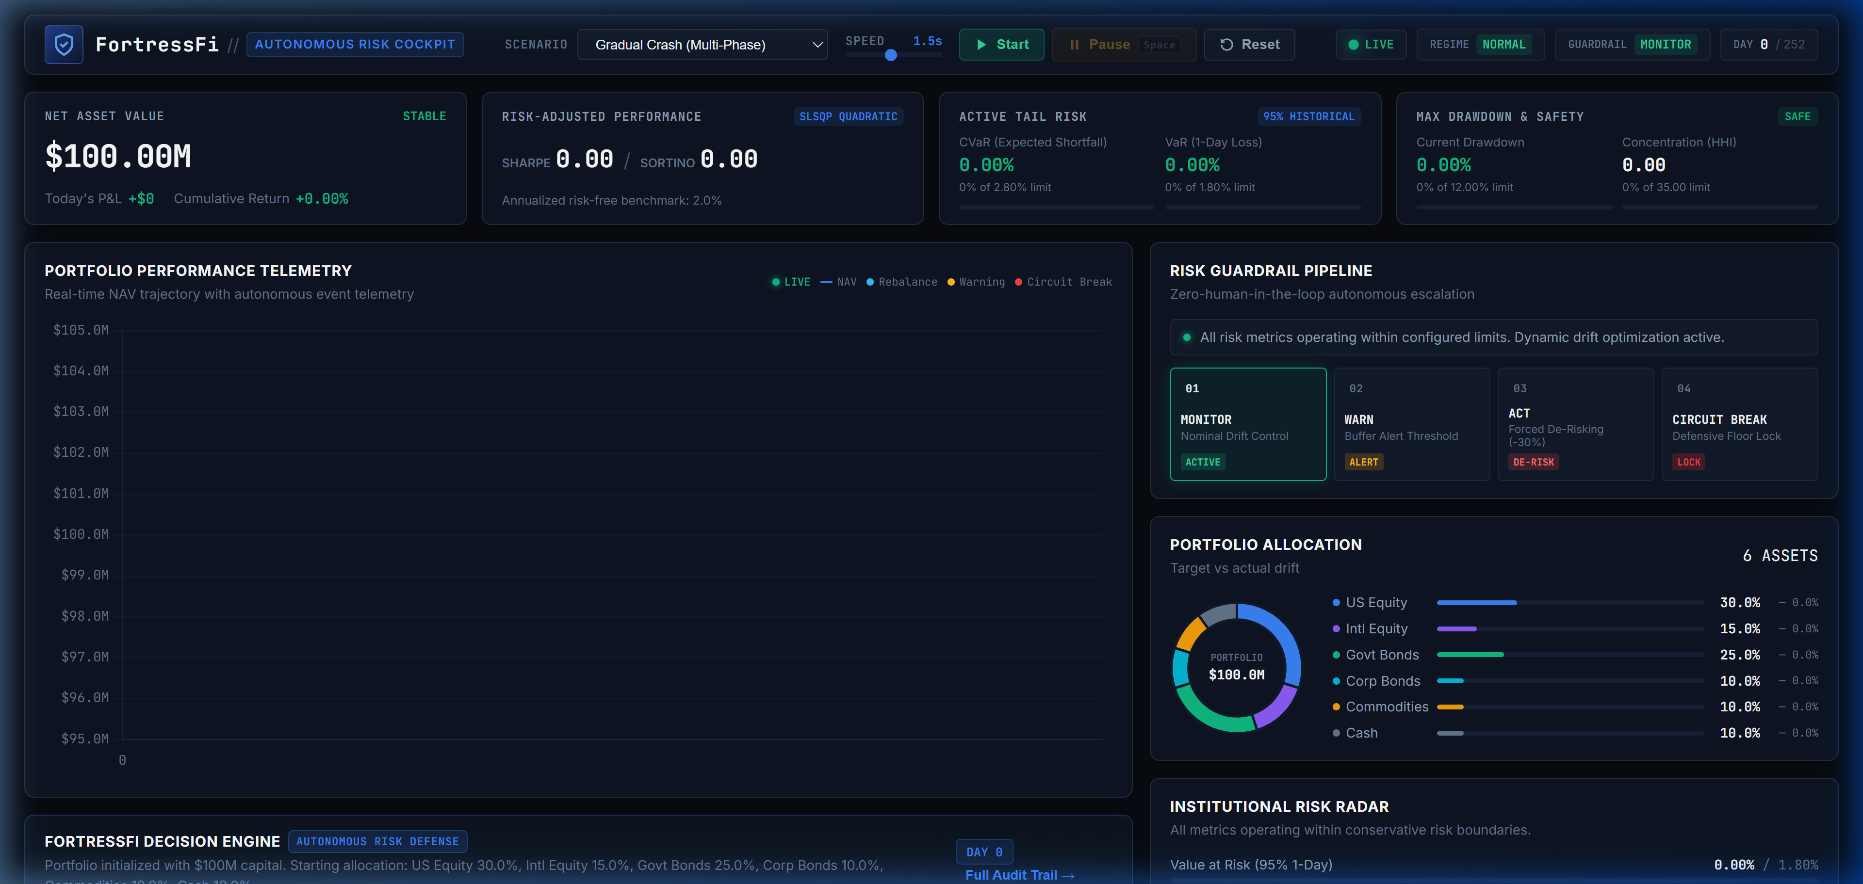
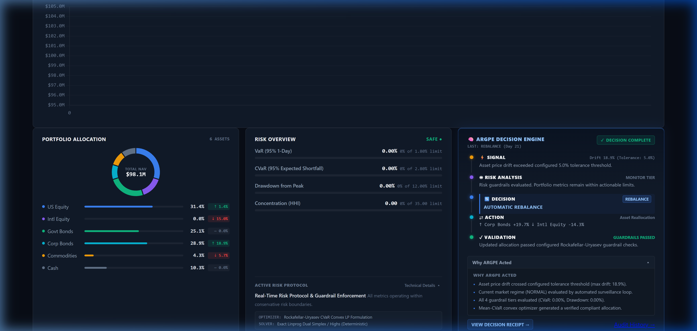
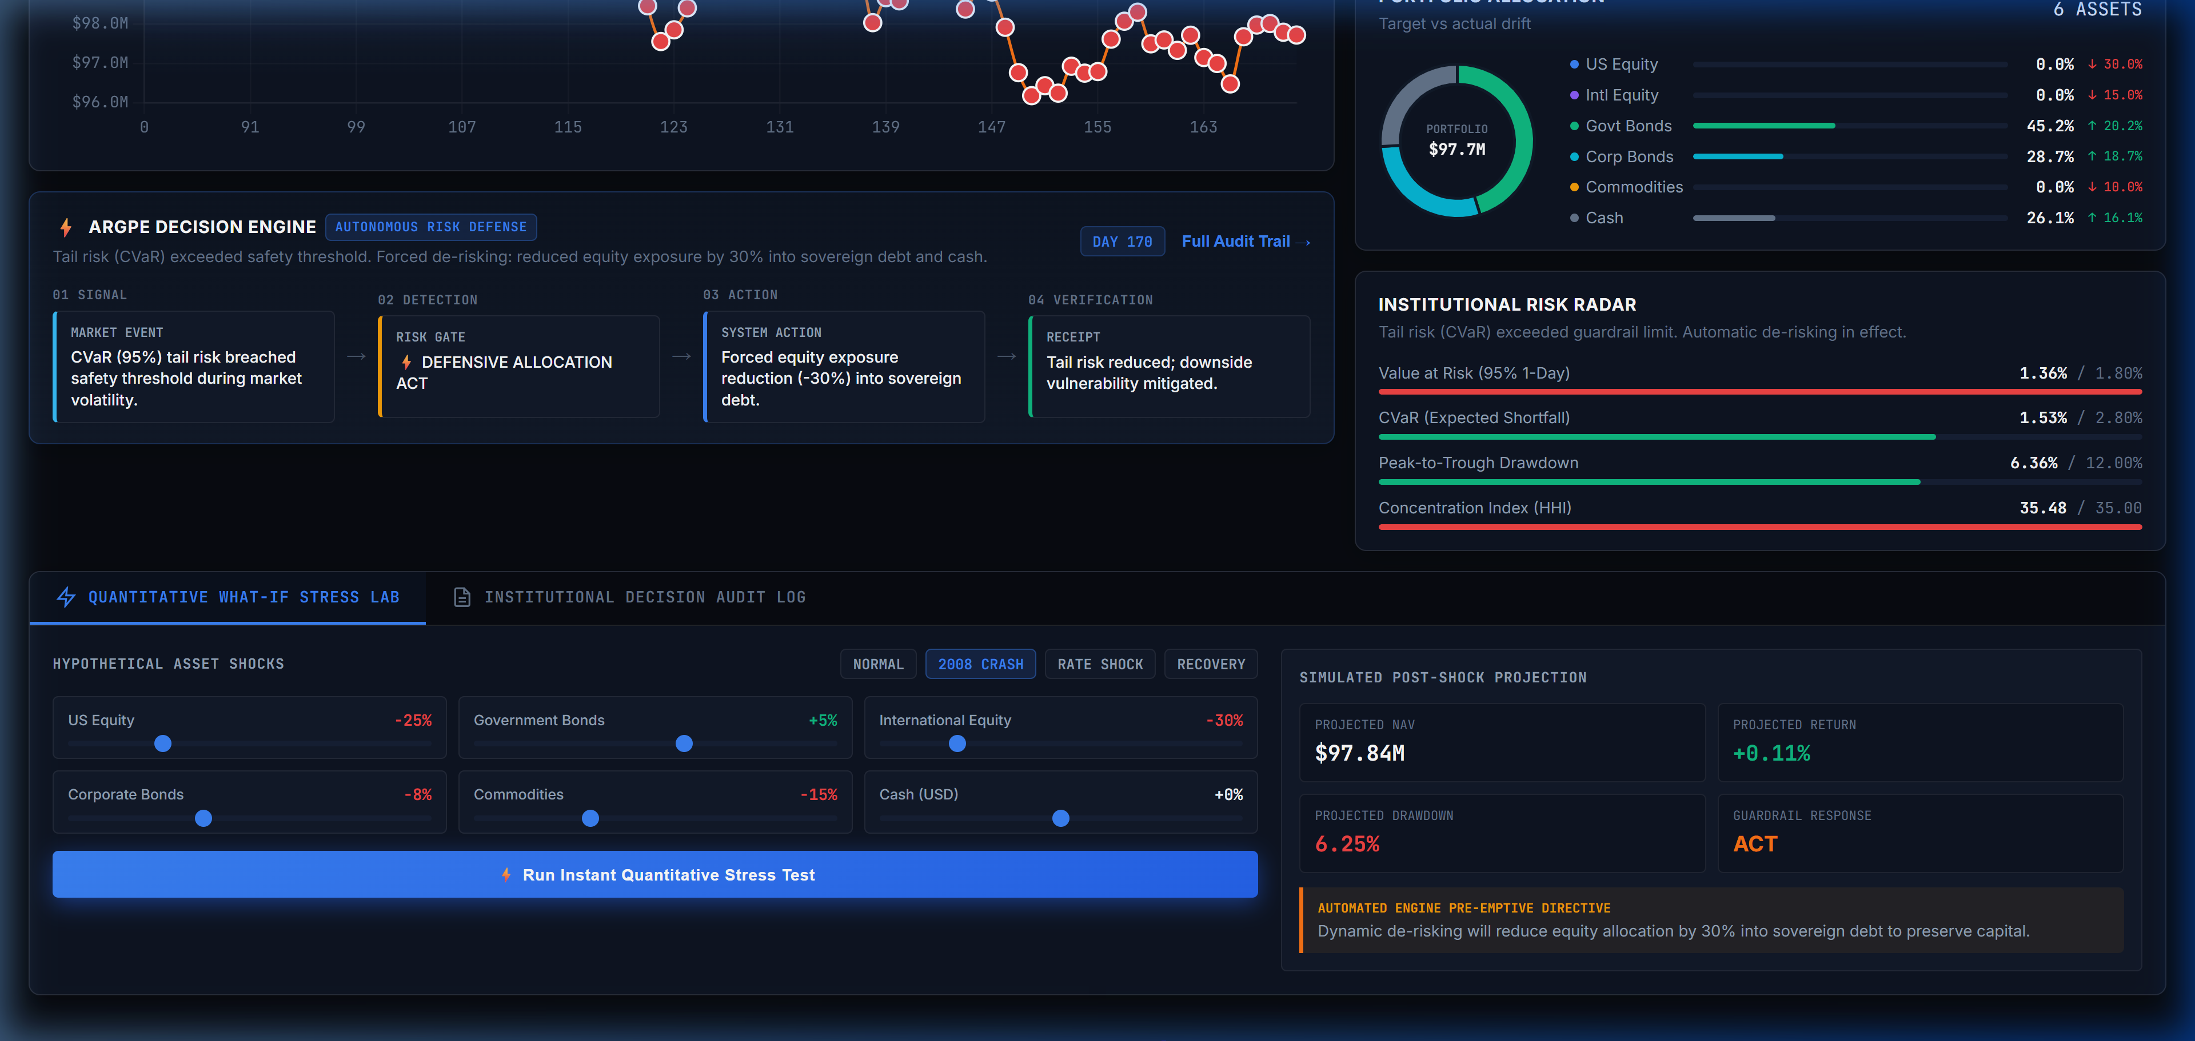
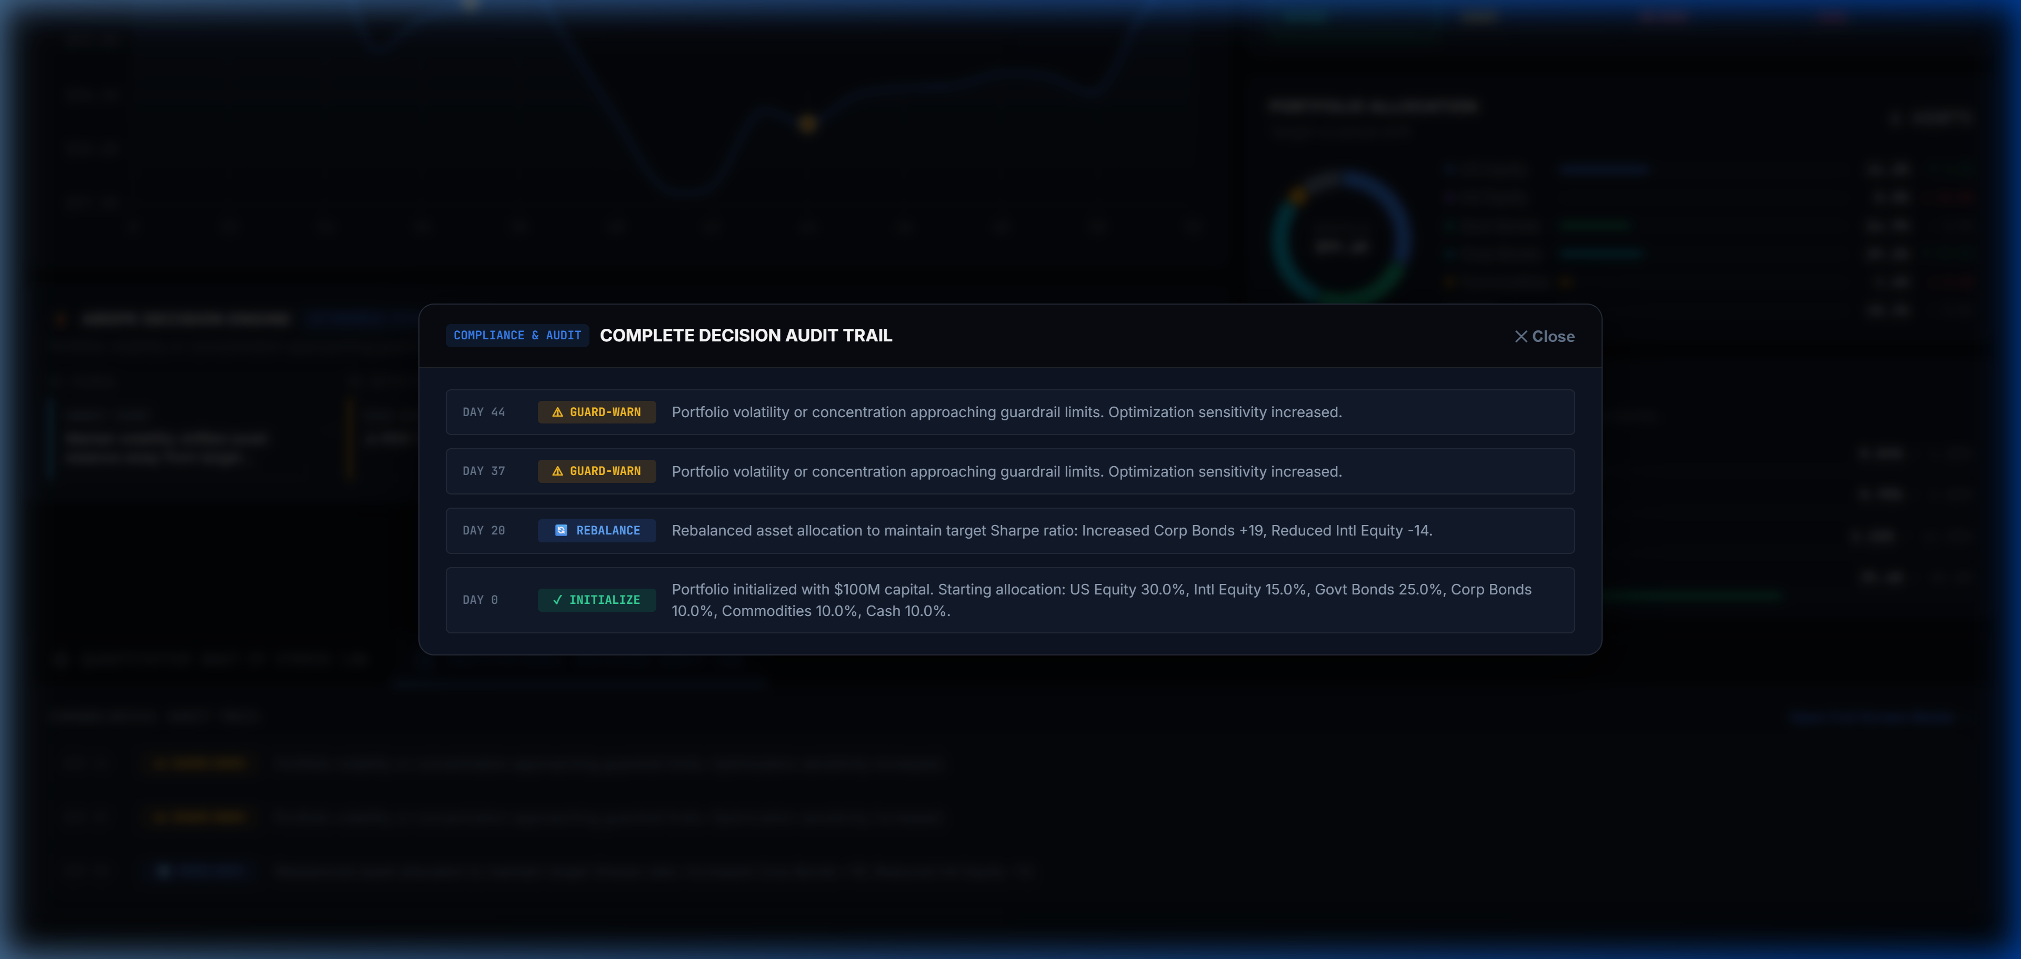
SLIDE 5 : PROJECT SNAPSHOTS
Live Institutional Cockpit & NAV Chart
Pulsing Guardrail banner (🟢 MONITOR), top KPIs, and dynamic line chart.
Live Institutional Cockpit & NAV Chart
Pulsing Guardrail banner (🟢 MONITOR), top KPIs, and dynamic line chart.
Asset Allocation Donut & Live Drift Meters
Donut breakdown across 6 asset classes with real-time drift indicators.
Asset Allocation Donut & Live Drift Meters
Donut breakdown across 6 asset classes with real-time drift indicators.
Interactive What-If Scenario Simulator
Allows risk managers to dial in custom market shocks and observe projected impact.
Interactive What-If Scenario Simulator
Allows risk managers to dial in custom market shocks and observe projected impact.
Explainable AI Decision Audit Log
Every single trade is translated into plain-English rationale for C-suite transparency.
Explainable AI Decision Audit Log
Every single trade is translated into plain-English rationale for C-suite transparency.

Slide 7
SLIDE 6 : FEASIBILITY/VIABILITY AND IMPACT
1. TECHNICAL FEASIBILITY
Proven benchmarks from our prototype:
• Lightning-Fast Execution:
Optimization converges in 11.4 milliseconds. Risk checks execute in under 2 milliseconds.
• Zero Cloud / API Fragility:
Entire financial engine runs locally without fragile third-party API dependencies. It cannot be taken down by external rate limits.
• Rigorous Automated Tests:
40 automated unit & integration tests covering math, drift gating, and circuit breakers execute in just 0.25 seconds with 100% pass rate.
1. TECHNICAL FEASIBILITY
Proven benchmarks from our prototype:
• Lightning-Fast Execution:
Optimization converges in 11.4 milliseconds. Risk checks execute in under 2 milliseconds.
• Zero Cloud / API Fragility:
Entire financial engine runs locally without fragile third-party API dependencies. It cannot be taken down by external rate limits.
• Rigorous Automated Tests:
40 automated unit & integration tests covering math, drift gating, and circuit breakers execute in just 0.25 seconds with 100% pass rate.
2. ECONOMIC VIABILITY & ROI
Measurable cost savings for investors:
• 60% to 80% Less Trading Fees:
By avoiding constant micro-rebalancing, our drift-based execution dramatically reduces transaction penalties and slippage.
• Millisecond Crash Protection:
Replaces 30-minute panic meetings and emotional manual trading with automated, rule-governed capital preservation.
• Downside Loss Limitation:
Historically, shielding capital during top 5% worst market days boosts multi-year compound returns by over 30%.
2. ECONOMIC VIABILITY & ROI
Measurable cost savings for investors:
• 60% to 80% Less Trading Fees:
By avoiding constant micro-rebalancing, our drift-based execution dramatically reduces transaction penalties and slippage.
• Millisecond Crash Protection:
Replaces 30-minute panic meetings and emotional manual trading with automated, rule-governed capital preservation.
• Downside Loss Limitation:
Historically, shielding capital during top 5% worst market days boosts multi-year compound returns by over 30%.
3. PRACTICAL REAL-WORLD IMPACT
Who benefits from FortressFi today:
• Retail & Student Investors:
Gives ordinary people access to institutional-grade risk controls so they can invest without fear of waking up to a wiped-out portfolio.
• Corporate Treasuries & Family Offices:
Companies holding cash reserves can optimize yield while guaranteeing that strict liquidity covenants are never breached.
• WealthTech & Neo-Brokers:
A ready-to-integrate API engine that platforms (like Zerodha or Robinhood) can plug in to offer automated 'Safe Cruise' features.
3. PRACTICAL REAL-WORLD IMPACT
Who benefits from FortressFi today:
• Retail & Student Investors:
Gives ordinary people access to institutional-grade risk controls so they can invest without fear of waking up to a wiped-out portfolio.
• Corporate Treasuries & Family Offices:
Companies holding cash reserves can optimize yield while guaranteeing that strict liquidity covenants are never breached.
• WealthTech & Neo-Brokers:
A ready-to-integrate API engine that platforms (like Zerodha or Robinhood) can plug in to offer automated 'Safe Cruise' features.

Slide 8
SLIDE 7 : REFERENCES
1. WHY FORTRESSFI WINS
Clear comparison against alternatives:
• Traditional Wealth Management:
❌ Static calendar rebalancing (slow) ❌ Zero flash crash protection ❌ Delayed quarterly PDFs
• Generic Robo-Advisors:
❌ One-time static risk questionnaires ❌ High turnover friction fees ❌ Opaque black-box trades
• FortressFi (Our Prototype):
✅ Adaptive drift-gated execution ✅ 4-tier autonomous de-risking ✅ Plain-English Decision Audit Log
1. WHY FORTRESSFI WINS
Clear comparison against alternatives:
• Traditional Wealth Management:
[-] Static calendar rebalancing (slow) [-] Zero flash crash protection [-] Delayed quarterly PDFs
• Generic Robo-Advisors:
[-] One-time static risk questionnaires [-] High turnover friction fees [-] Opaque black-box trades
• FortressFi (Our Prototype):
[+] Adaptive drift-gated execution [+] 4-tier autonomous de-risking [+] Plain-English Decision Audit Log
2. FINANCIAL & SCIENTIFIC BACKING
Built on proven financial engineering:
1. Markowitz, Harry (1952)
'Portfolio Selection', Journal of Finance. (Foundation of Mean-Variance optimization).
2. Rockafellar & Uryasev (2000)
'Optimization of Conditional Value-at-Risk', Journal of Risk. (Tail risk management).
3. Basel Committee (FRTB - 2019)
Global banking standards mandating Expected Shortfall / CVaR for market risk.
4. Dieter Kraft (1988)
Sequential Least Squares Quadratic Programming (SLSQP).
2. FINANCIAL & SCIENTIFIC BACKING
Built on proven financial engineering:
1. Markowitz, Harry (1952)
'Portfolio Selection', Journal of Finance. (Foundation of Mean-Variance optimization).
2. Rockafellar & Uryasev (2000)
'Optimization of Conditional Value-at-Risk', Journal of Risk. (Tail risk management).
3. Basel Committee (FRTB - 2019)
Global banking standards mandating Expected Shortfall / CVaR for market risk.
4. Dieter Kraft (1988)
Sequential Least Squares Quadratic Programming (SLSQP).
3. OPEN-SOURCE CODE & DELIVERABLES
Everything is built, verified, and public:
• GitHub Repository:
https://github.com/tarun05-design/FortressFi.git
• Live Interactive Cockpit:
http://localhost:8000 (Real-time WebSockets & Scenario Lab)
• Verification Metrics:
40 Automated Tests Passing (0.25s) Comprehensive Architecture Documentation Zero External API Failure Risk
• Team Contact:
Built proudly for Init26 FinTech Hackathon
3. OPEN-SOURCE CODE & DELIVERABLES
Everything is built, verified, and public:
• GitHub Repository:
https://github.com/tarun05-design/FortressFi.git
• Live Interactive Cockpit:
http://localhost:8000 (Real-time WebSockets & Scenario Lab)
• Verification Metrics:
40 Automated Tests Passing (0.25s) Comprehensive Architecture Documentation Zero External API Failure Risk
• Team Contact:
Built proudly for Init26 FinTech Hackathon

